Slide 1
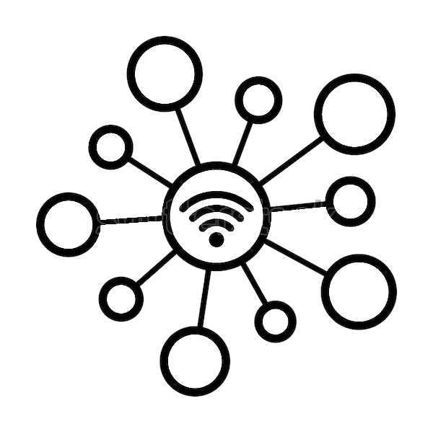

CG4001 Final Year Project
H638180 Security and Privacy in the Internet of Things

Slide 2
Specific Area of Focus
Wireless Fidelity (Wi-Fi)

Slide 3
Abbreviations
OFDM = Orthogonal Frequency Division Multiplexing
OFDMA = Orthogonal Frequency Division Multiple Access
AWGN / AGWN = Additive White Gaussian Noise

Slide 4
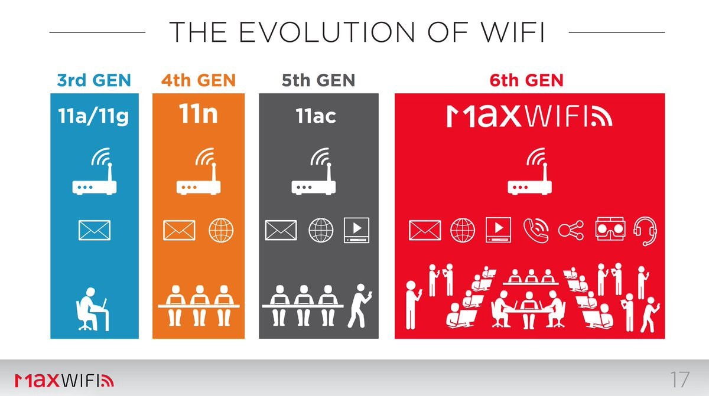
Specific Area of Focus

Slide 5
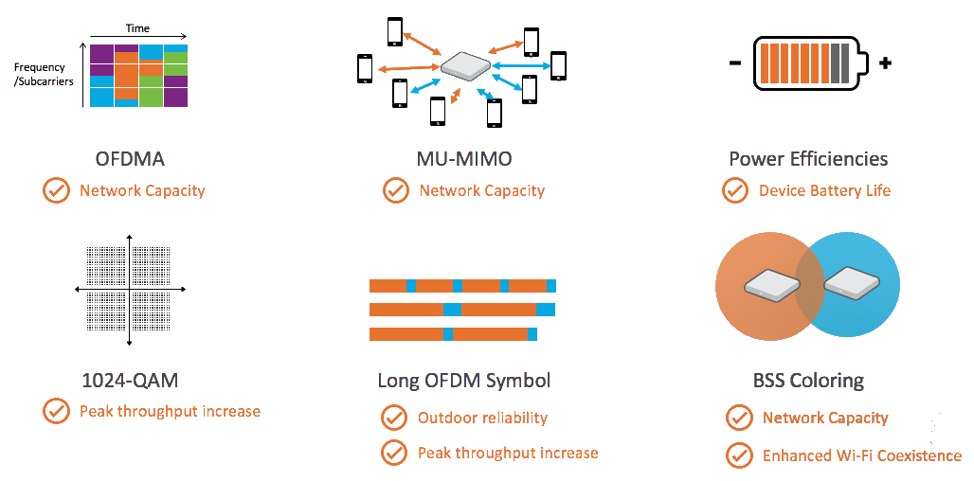
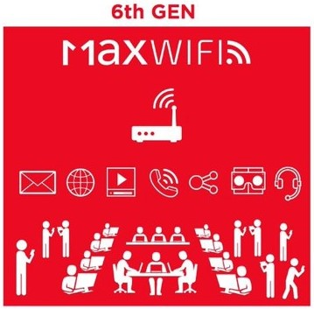
Why switch to Wi-Fi 6?

Slide 6

What is OFDMA?
Orthogonal
Frequency Division
Multiple Access
Multiplexing

Slide 7
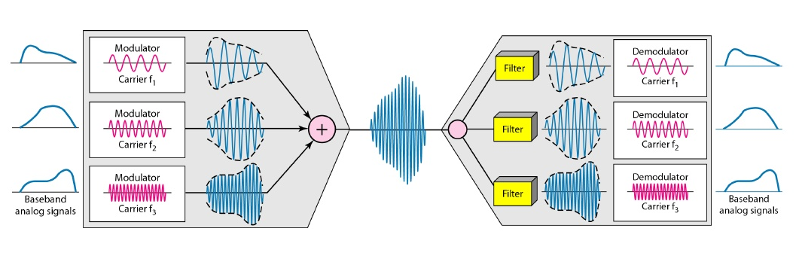
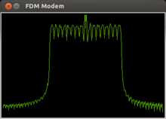
Frequency Division Multiplexing

Slide 8
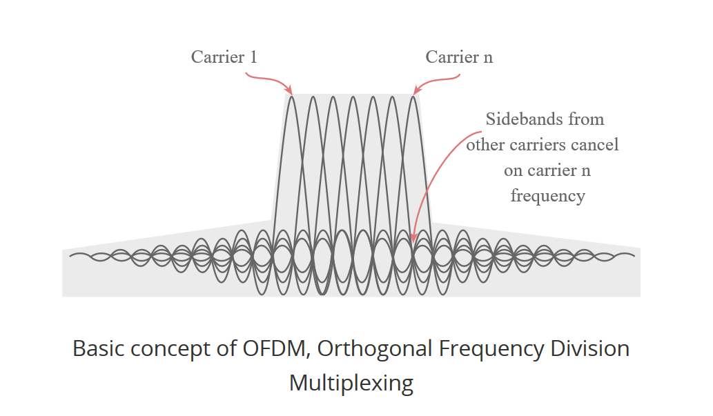
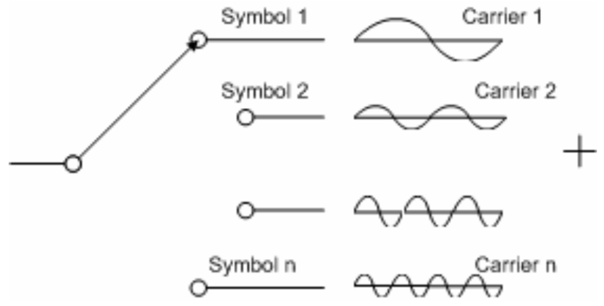
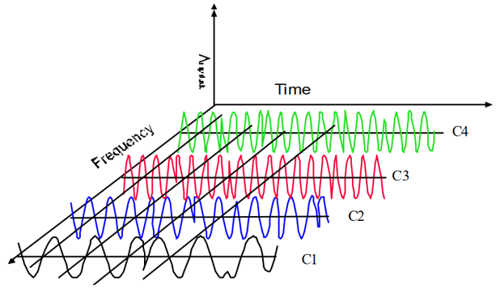
Orthogonality

Slide 9
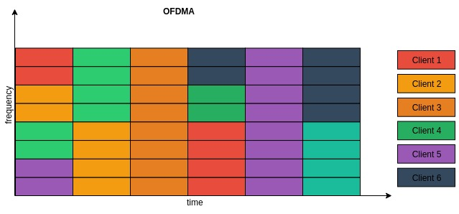
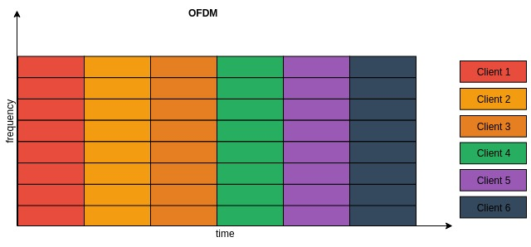
Multiple Access

Slide 10
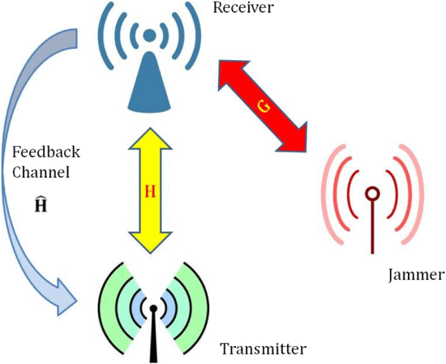
Research Focus
Attacks against OFDMA
Specifically, using jamming signals to disrupt the way signals are transmitted by OFDMA

Slide 11
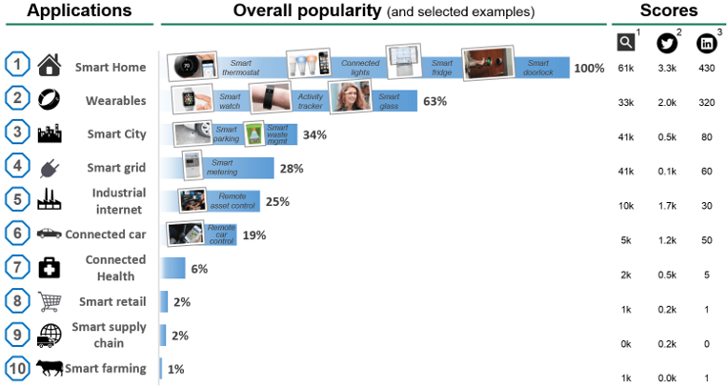
Link to Project Title
IoT devices work by connecting to the internet.
As no of IoT devices ↑, many more would also adopt Wi-Fi 6 & OFDMA.
Jamming attacks → Compromising Availability of IoT devices → Disrupt city systems and daily lives

Slide 12
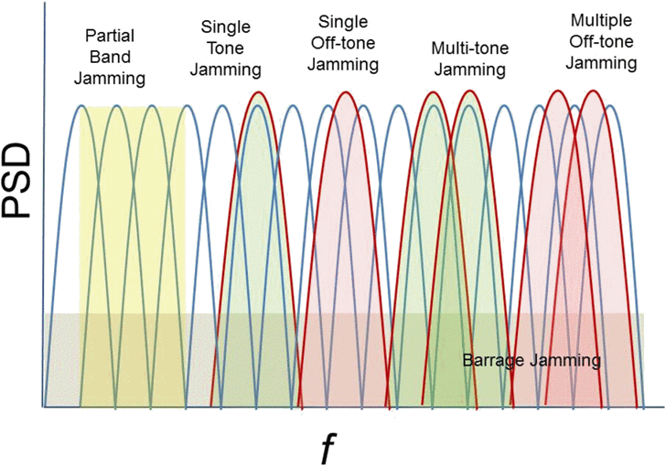
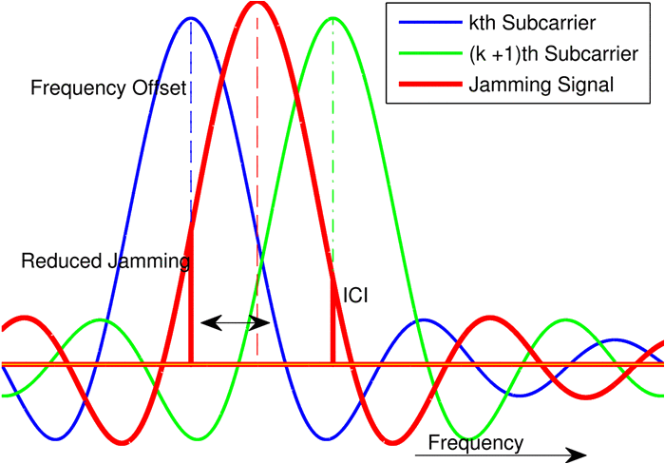
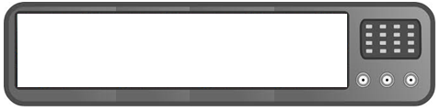
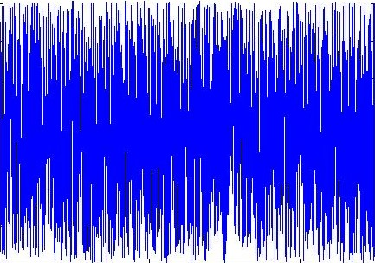
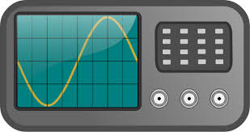
Types of Jamming
Barrage Jamming (BNJ)
Partial Band Jamming (PBJ)
Multi-Tone Jamming (MTJ)
Asynchronous Off-Tone Jamming

Slide 13

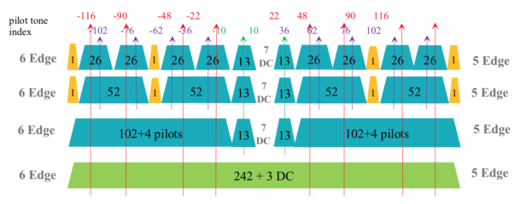
Types of Jamming
Pilot Jamming
Pilot Nulling
represents a pilot tone.

Slide 14
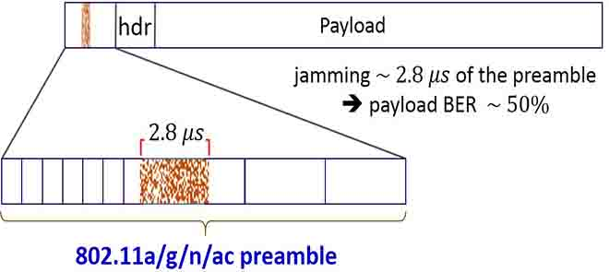
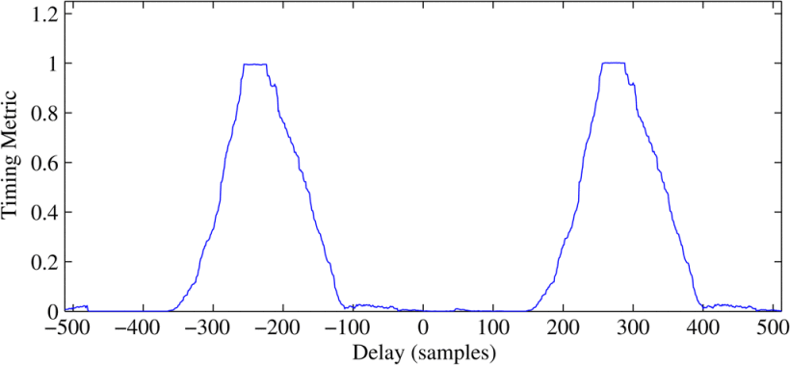

Types of Jamming
False Preamble Timing Attack
Preamble Nulling
Preamble Phase Warping
Original
False Preamble

Slide 15
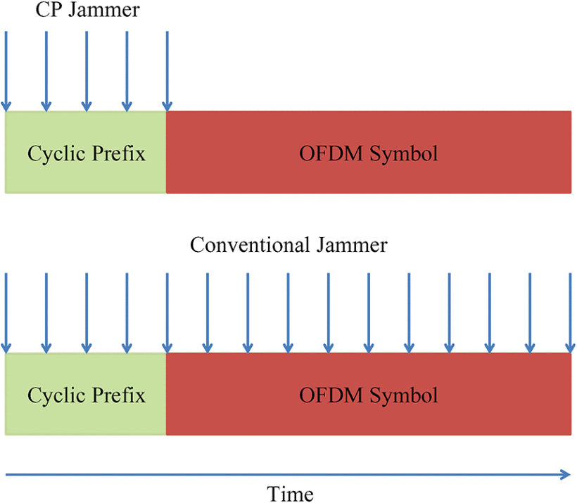
Types of Jamming
Cyclic Prefix Jamming

Slide 16
Types of Jamming
Hybrid Acknowledgement reQuest Attack
Resource Allocation Attack
Random Access Channel Attack

Slide 17
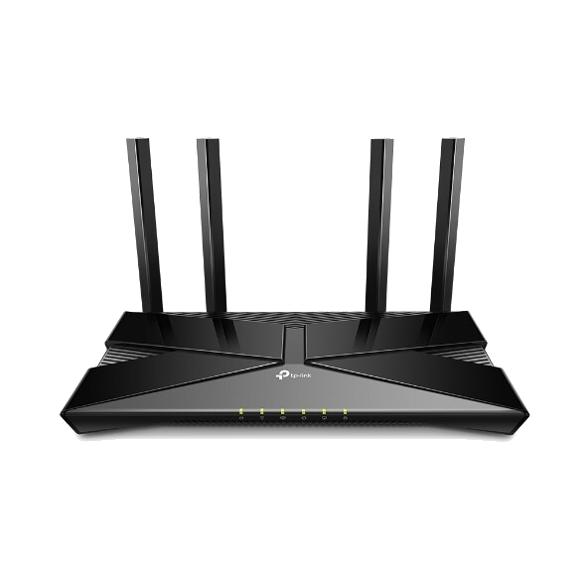
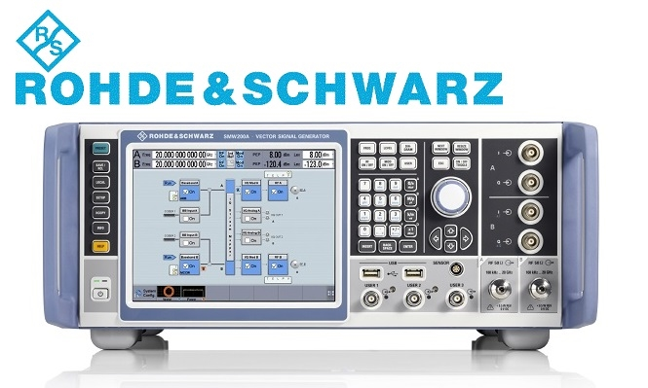
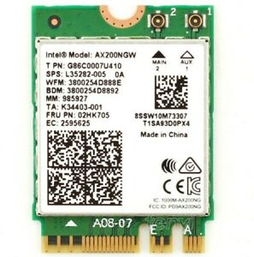
Experimentation
Tested:
Barrage Jamming, Partial Band Jamming, Multi-Tone Jamming, Asynchronous Off-Tone Jamming

Slide 18
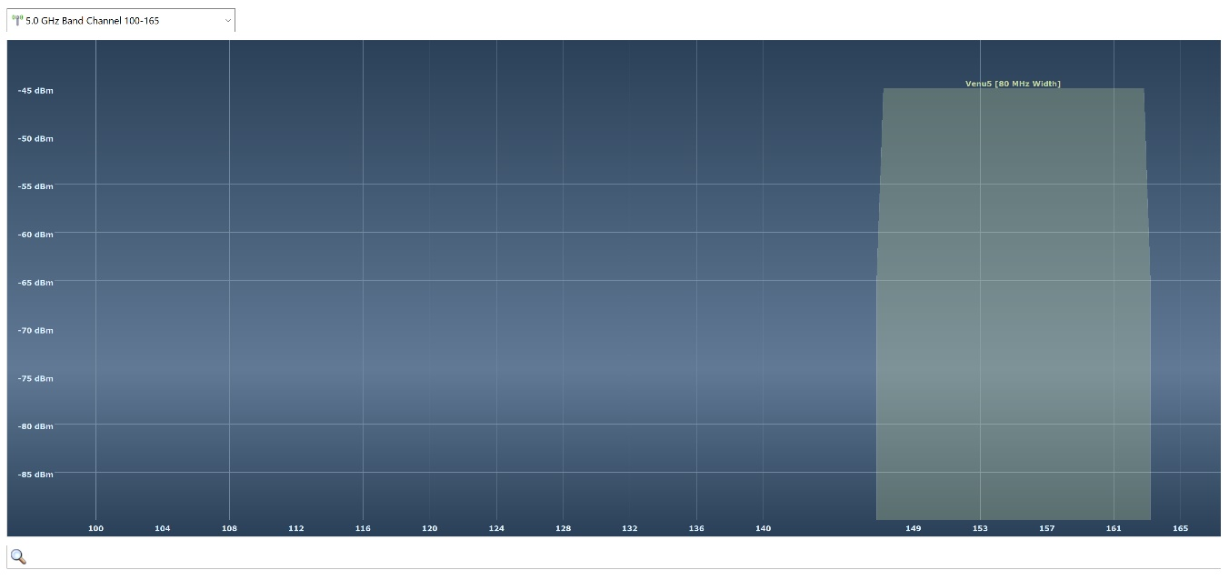
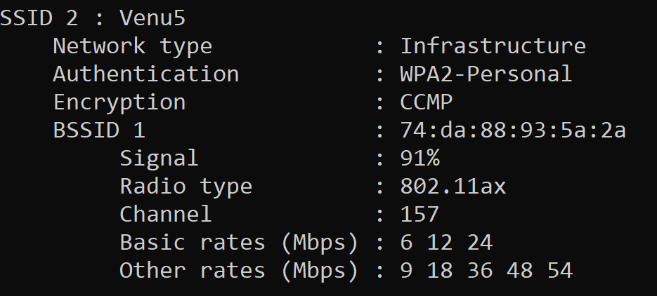
Operating Parameters
Channels 149, 153, 157 & 161

Slide 19
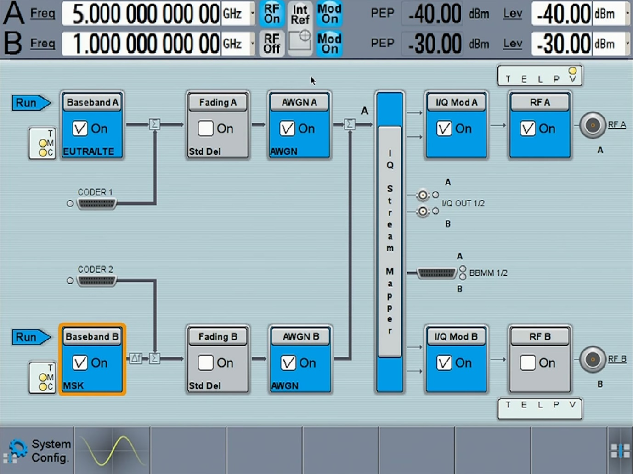
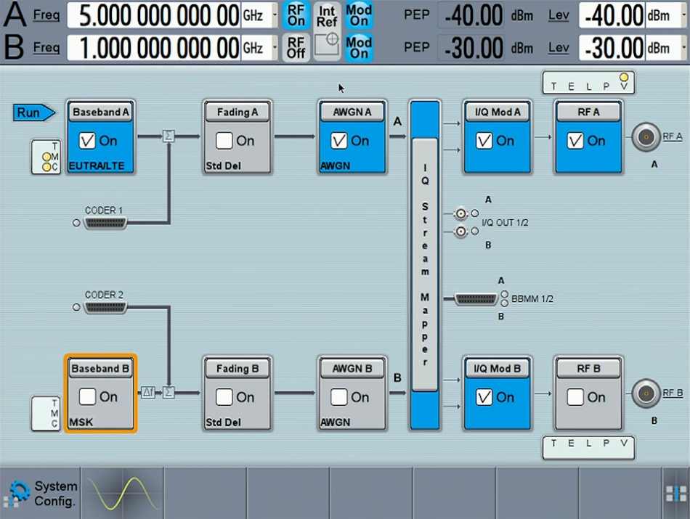
Operating Parameters

Slide 20



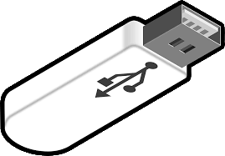




Set-up
Receiver
UDP
Transmitter
1m
1m
No ACKs
Jammer

Slide 21
Procedure
head -c 51200 </dev/urandom > myfile.txt
gcc –g –Wall –o udpCli udp_client.c
./udpCli 192.168.0.223
Canonical name: 192.168.0.223
AF_INET
File length: 51200 bytes
File sent successfully!
...
hostname -I
192.168.0.223
gcc –g –Wall –o udpSvr udp_svr.c
./udpSvr
Start receiving
File successfully received!
Total data received: 51200 bytes

Slide 22
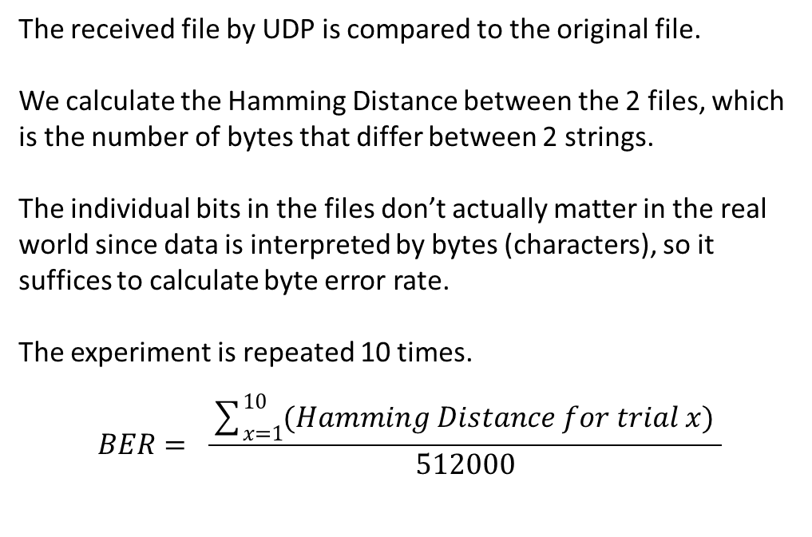
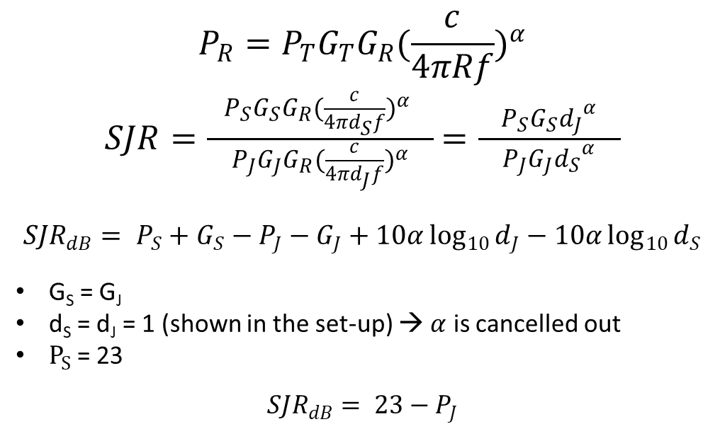
Quantification and Calculation
Signal-to-Jammer Ratio (SJR)
Bit Error Rate (BER)
$$P_{R}=P_{T}G_{T}G_{R}{(\frac{c}{4πRf})}^{α}$$
$SJR=\frac{ P_{S}G_{S}G_{R}{(\frac{c}{4πd_{S}f})}^{α} }{P_{J}G_{J}G_{R}{(\frac{c}{4πd_{J}f})}^{α}}$ $=\frac{ P_{S}G_{S}{d_{J}}^{α} }{P_{J}G_{J}{d_{S}}^{α}}$
$${SJR}_{dB}= P_{S}+G_{S}−P_{J}−G_{J}+10α\log_{10}{d_{J}}−10α\log_{10}{d_{S}}$$
G_{S} = G_{J}
d_{S} = d_{J} = 1 (shown in the set-up) → $α$ is cancelled out
$P_{S}$= 23
$${SJR}_{dB}= 23−P_{J}$$
The received file by UDP is compared to the original file.
We calculate the Hamming Distance between the 2 files, which is the number of bytes that differ between 2 strings.
The individual bits in the files don’t actually matter in the real world since data is interpreted by bytes (characters), so it suffices to calculate byte error rate.
The experiment is repeated 10 times.
$$BER= \frac{\sum_{x=1}^{10}{(Hamming Distance for trial x) }}{512000}$$
23

Slide 23
Experiment Results

Slide 24
Conclusion
Contributions – Designed a novel experiment that uses readily available commercial equipment (aside from the jammer, since it isn’t easy to find one given it’s illegal).
How the new OFDMA holds up against past jamming attacks
Partial Band Jamming and Multi-Tone Jamming more power-efficient than Barrage Jamming since reduced bandwidth. However, deal less damage.
Asynchronous off-tone jamming, despite consuming same power as Multi-Tone Jamming, causes noticeably more damage

Slide 25
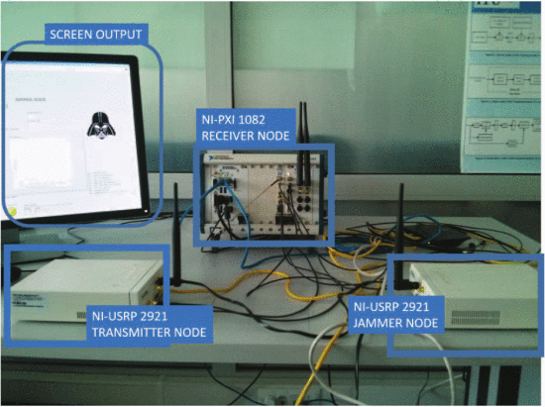
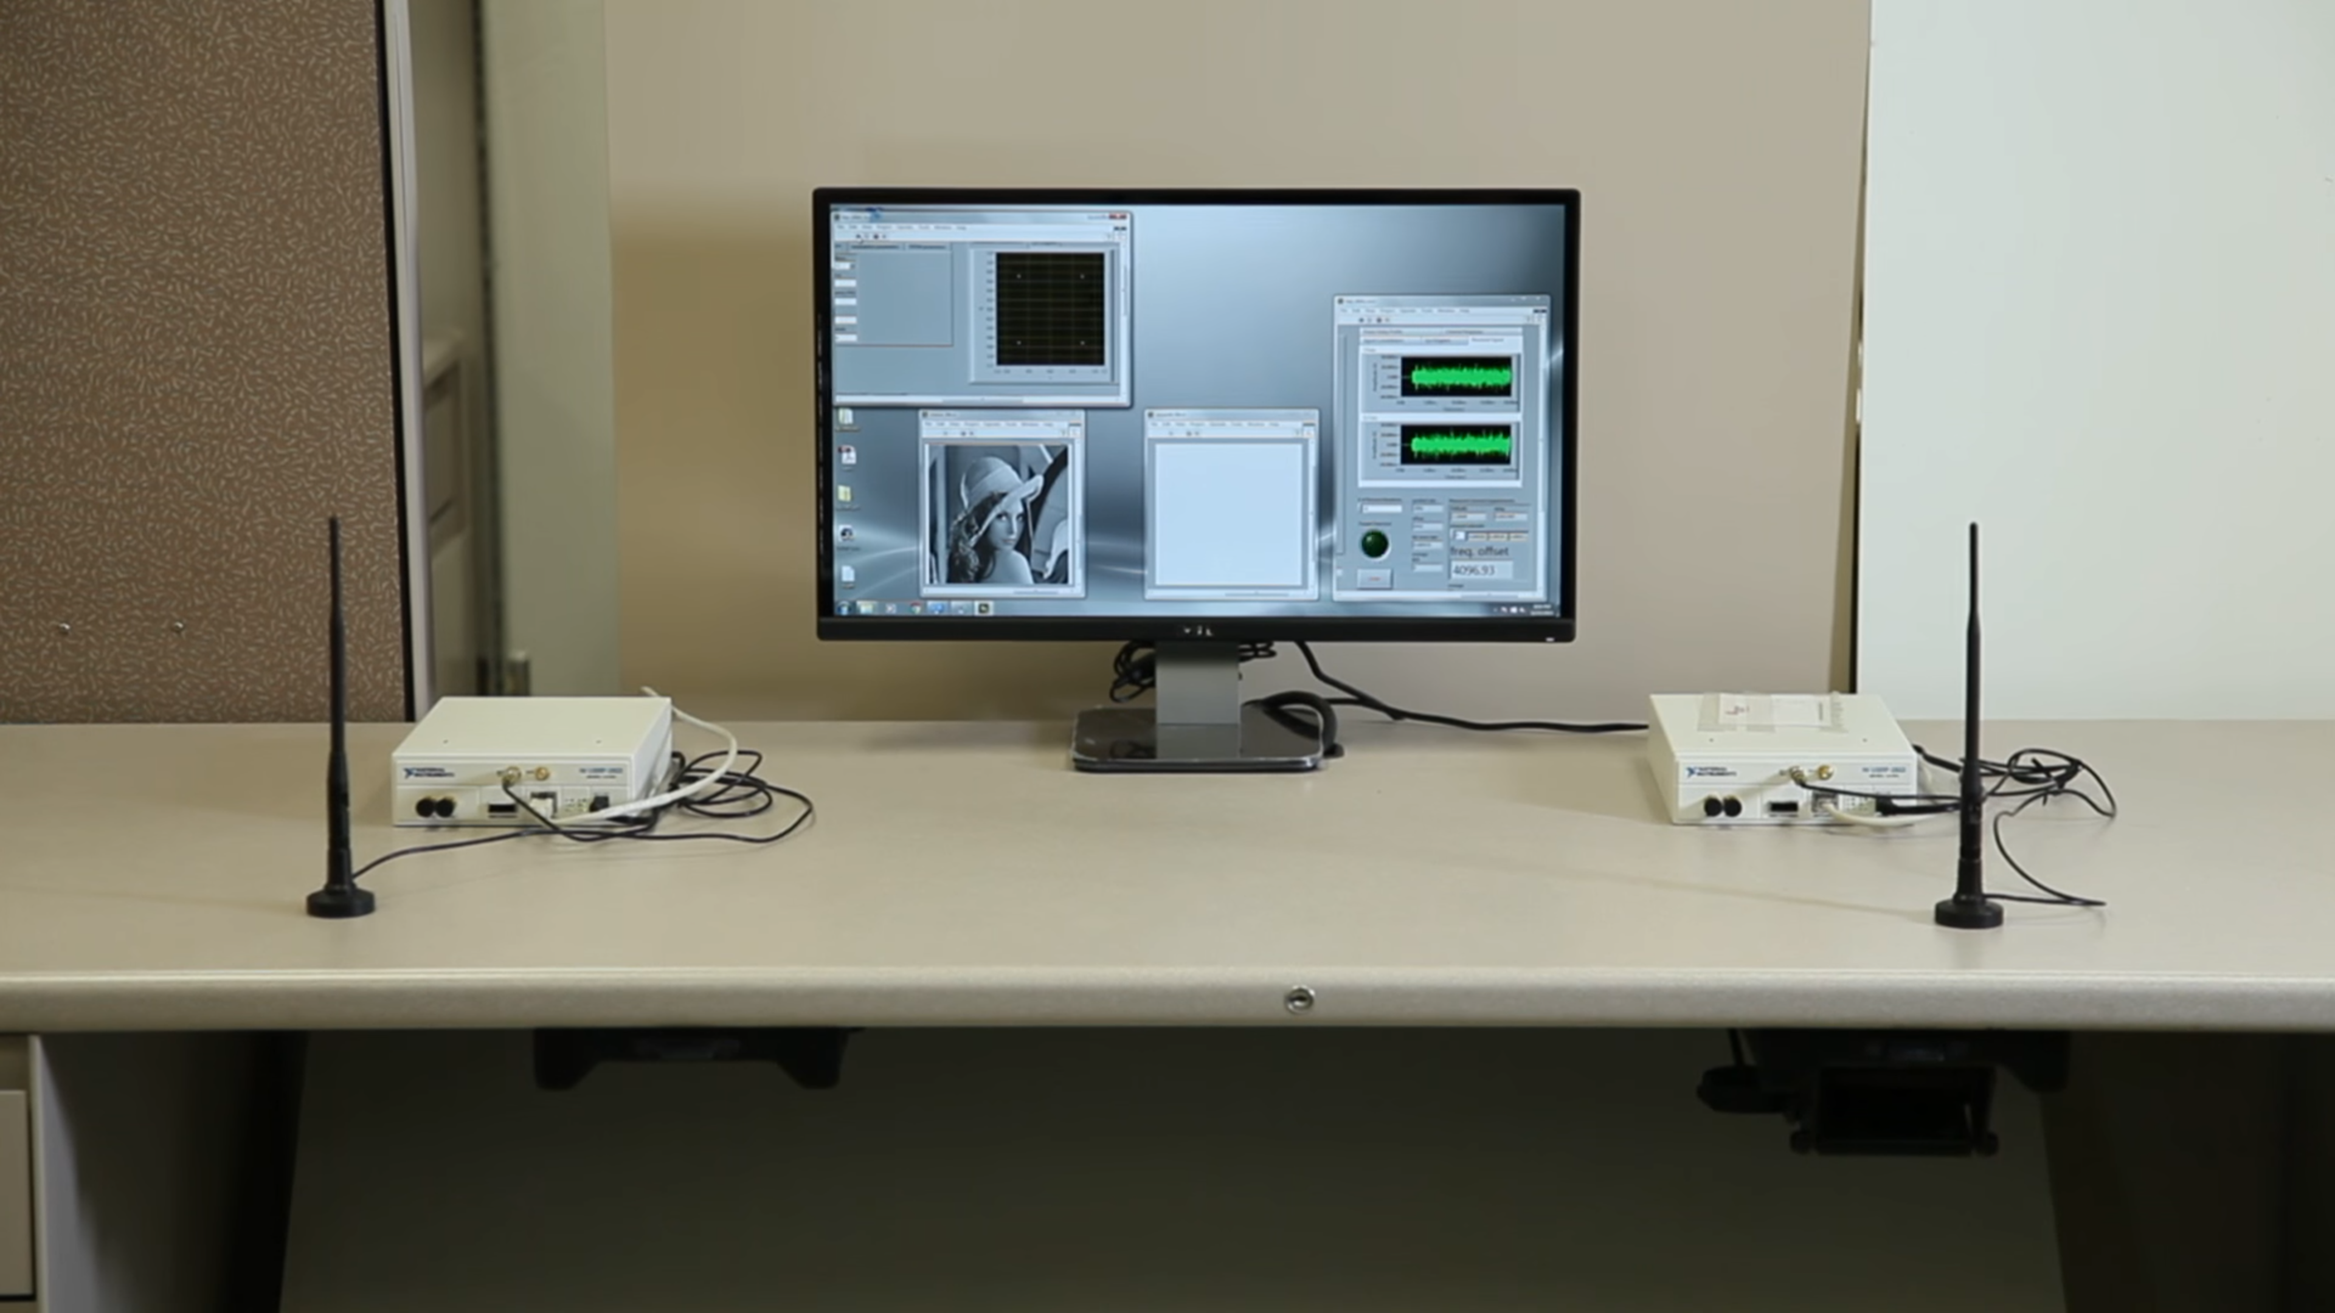
Other Researches
NI-USRP 2922
Transmitter Node
NI-USRP 2922
Transmitter Node
NI-USRP 2922
Jammer Node

Slide 26
Future Work
Other attacks mentioned in this paper were not tested against this new Wi-Fi 6 technology
Past researchers have done well to document the effects of many attacks on past Wi-Fi standards.
However, the new Wi-Fi 6 technology employs OFDMA, different from the OFDM which was tested

Slide 27
Flow of Presentation
OFDMA Intro - Talk about FDM, then OFDM, then OFDMA
Talk about specific area of research (jamming signals)
How jamming link to project title
Previous types of jamming – OFDM and OFDMA
How my experiment is being conducted
Go through apparatus
Go through procedure
How my experiment is different (use commercially available equipment)
Go through experiment results
Conclude, Future work

